Slide 1
*This page is intentionally left blank

Slide 2
My latest hobby

Slide 3
About Today’s: what we do
Web design & development
Internet Marketing Campaigns (focused on SearchEngineMarketing & Email Marketing)

Slide 4
About Today’s

Slide 5
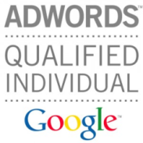
About Today’s SEM
Worked in multiple industries (tourism, pharma, b2b services, private medicine)
Over $500k managed in Google AdWords
Google Adwords CertifiedPartner
Unique tool that monitors the market
(we know almost everything about .RO AdWords advertisers: budgets, keywords, ads)

Slide 6
Before Choosing Tools
1. What Problem are you solving ?
2. Which tools can help?
3. When does it makes sense to invest in tools?

Slide 7
This presentation’s topic
2%
%

Slide 8
This presentation’s topic
20 $ bn
world wide

Slide 9
Google AdWords

Slide 10
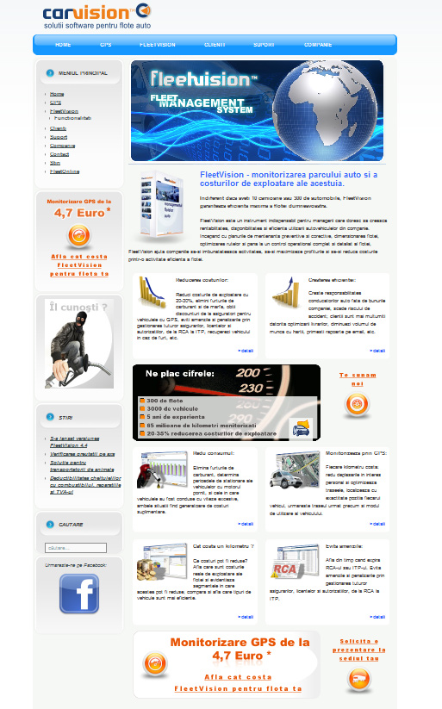
Lead Generation with Adwords
Prospect
B2B Lead Generation Campaign

Slide 11
Lead Generation with Adwords
Problem: You need more clients / sales
Tools: Google AdWords (opt: +agency) Landing Page/Website
When to do it: When you feel you can increase the revenue stream (the logistics can handle more clients)
When your competition is doing it

Slide 12
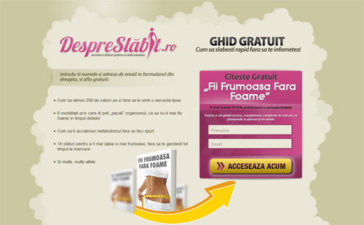
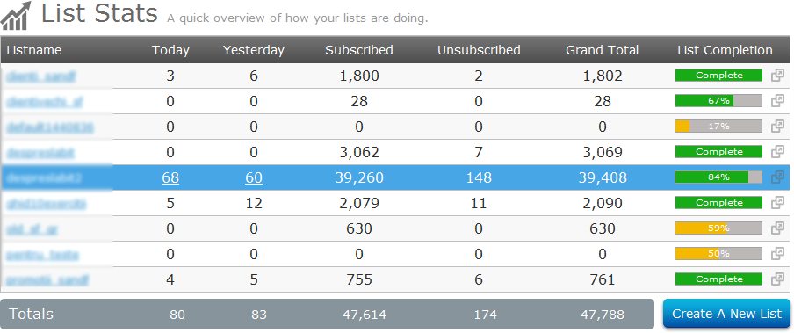
Build email marketing DB / Sell expensive products
Email marketing
Adwords for email marketing/espensive products

Slide 13
Build email marketing DB / Sell expensive products
Problem: You need more subscribers to your NL
You are selling an expensive product & want to keep the audience warm
Tools: Google AdWords (opt: +agency) Landing Page/Website Email Solution/Software + Copywriter
When to do it: When you want to address to a larger audience
Launch a product/promotion

Slide 14
Remarketing with Google AdWords
Google recently mentioned that “97% of new visitors do not convert the first time they arrive at your site.”
Introducing Remarketing:
When someone visits your website, you can drop a tracking cookie onto their computer. Later, when that individual is viewing other websites that utilize Google AdSense(like hotnews.ro), you can display your PPC ad in front of that user again via the Google AdWords Display Network
Think you have another chance to
make an impression
Subliminal messages do work
(You can use visual ads, texts)

Slide 16
Remarketing with Google AdWords
Problem: Didn’t close the sale/conversion
Tools: AdWords Remarketing
track: Visits to your Homepage
Visits to specific product pages
Visits to your shopping cart
Visits to your Contact page
When to do it: Since your first impression didn’t pull the visitor in enough to convert – let’s make the second one count!

Slide 17
Remarketing with Google AdWords

Slide 18
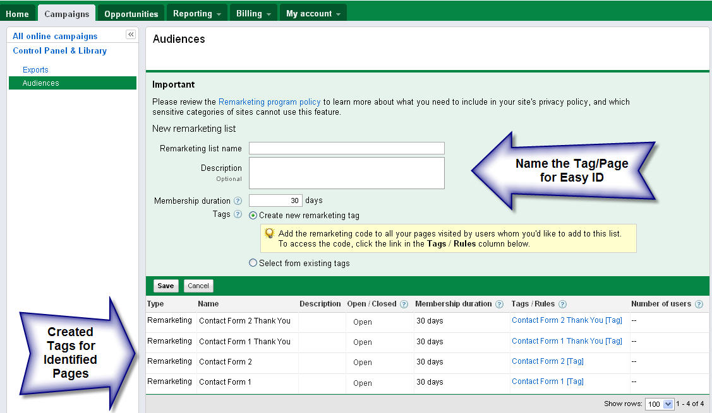
Remarketing with Google AdWords

Slide 19
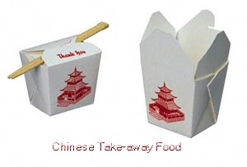
Takeaways
Search retargeting is the ability to target users based on user search history
Search is the best source of intent data
Search is the universal marketing language

