Slide 1
*This page is intentionally left blank

Slide 2
About Today’s: what we do
Web design & development
Internet Marketing Campaigns (focused on SearchEngineMarketing & Email Marketing)

Slide 3
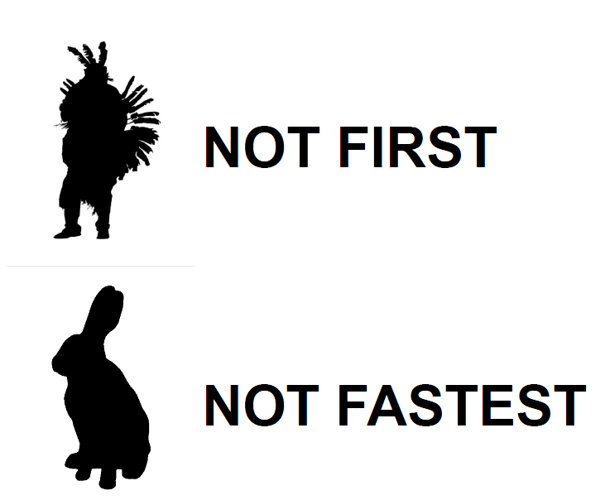
About Today’s

Slide 4
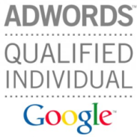
About Today’s SEM
Worked in multiple industries (tourism, pharma, b2b services, private medicine)
Over $700k managed in Google AdWords
Google Adwords CertifiedPartner
Unique tool that monitors the market
(we know almost everything about .RO AdWords advertisers: budgets, keywords, ads)

Slide 5
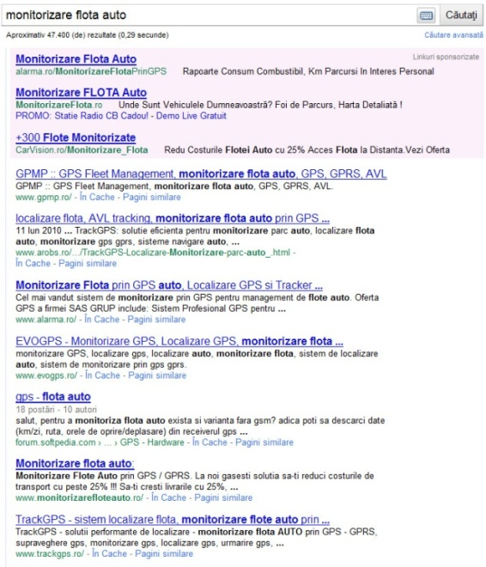
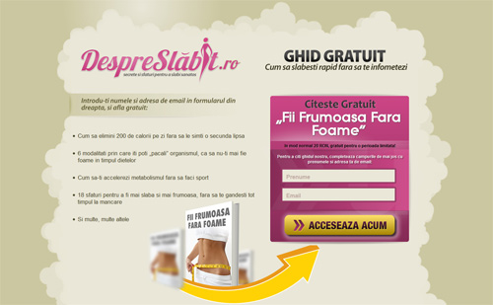
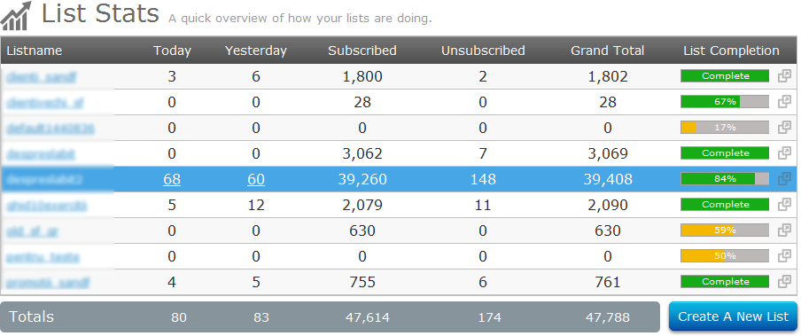
Build email marketing DB / Sell expensive products
Email marketing
Adwords for email marketing/espensive products

Slide 6
-Today’s AdWords Monitor-
Studiu privind prezenta Industriei financiare pe Google Adwords
Today’s AdWords Monitor:
12.861 website-uri romanesti monitorizate
1.128.232 cuvinte cheie
Aparitii Media
Ziarul Financiar IQads HotNews Money.ro Zoso.ro ☺

Slide 7
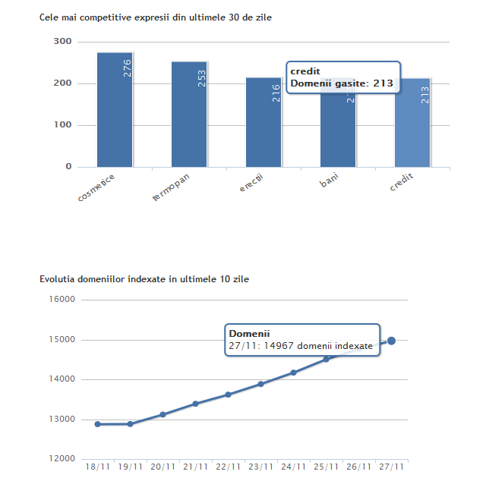
-Today’s AdWords Monitor-

Slide 8
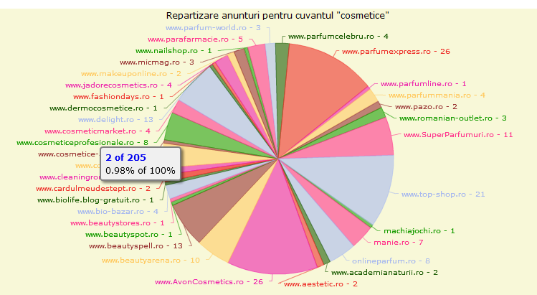
Today’s AdWords Monitor -cele mai competite expresii

Slide 9
Today’s AdWords Monitor -cei mai competivi advertiseri (#keywords)

Slide 10
Din ce industrii pot fi clientii Today’s pentru campaniile Google Adwords ?
cateva industrii:
dealeri auto / servicii b2b: contabilitate&consultanta / magazine online
portretul unei companii eligibile:
isi vinde produsele/serviciile in Bucuresti sau la nivel national
isi poate masura vanzarile sau este dispuse sa o faca
produsul/serviciul are o marja de profit de minim 30-50e/unitate
are un website
bugetul de marketing ii permite o investitie de 500e/luna

Slide 11
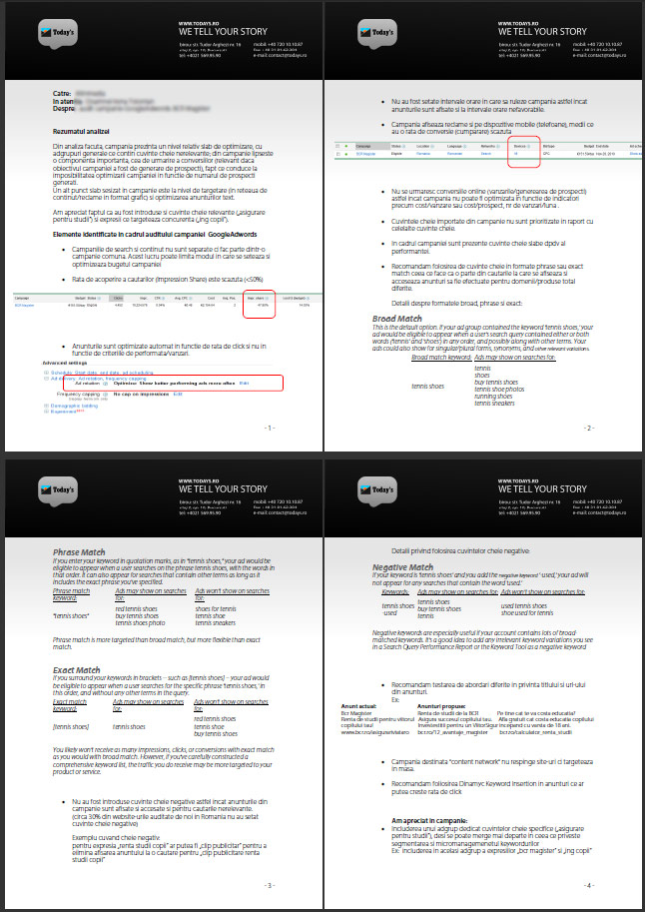
-Auditare campanii AdWords-
Industrii in care am desfasurat audituri
in ultimele 3 luni: Bancar, Auto,
Servicii Personale
Analizam 60 de elemente din campania AdWords. Analiza se face rapid, in 2 zile lucratoare
Implementarea recomandarilor poate
creste eficienta campaniei cu 10-80%
Experienta de peste 100 de audituri

Slide 12
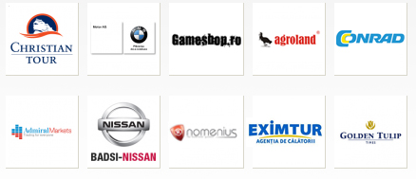
Some of our clients
Designated trademarks and brands are the property of their respective owners.

Slide 13
5 diferentiatori
Today’s Adwords Monitor
Auditare de campanii Adwords
Experienta de peste 700k E bugete gestionate
Experienta in lucrul cu branduri de top din industriile Auto & Turism
Campanii “two-step”: ppc + email marketing
Multumesc

