Slide 2
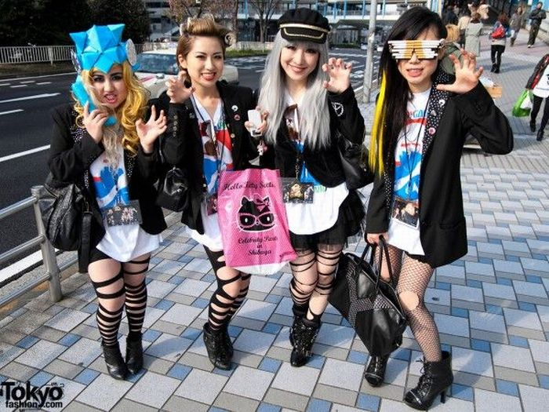
1. Construieste o comunitate

Slide 3
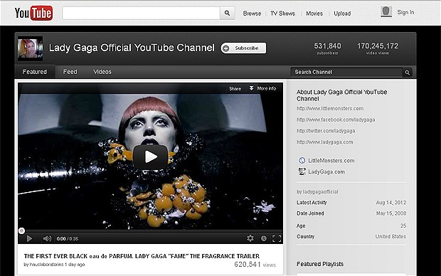
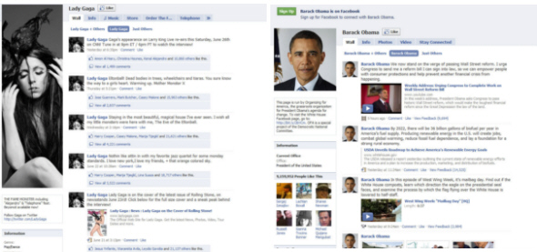
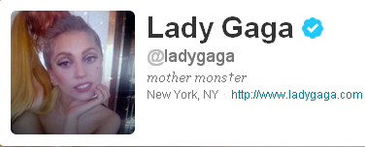
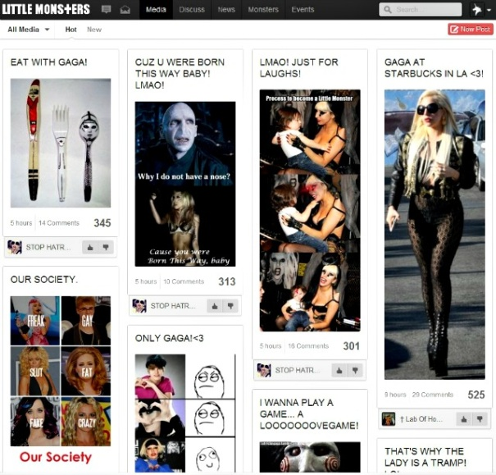
Adica?
1 miliard views
10 milioane fans
20 milioane followers
GeoHot
30% spike

Slide 4
Cum?
Clientul nostru, stapanul nostru
Oferte speciale pentru fani
Custom merch pentru fani
Bilete VIP (Monster Pit) prin retele sociale
Fanii sunt incurajati sa inregistreze concerte pe YouTube
Cauta interese comune, nu date demografice
Starbucks Digital Scavanger Hunt
Reclama Google Chrome
Google Goes Gaga
Vanzare “Born This Way” pe Amazon cu 0,99$ + 20GB storage
Live video feed pe BestBuy la lansare de album
Avanpremiera exclusiva pe iTunes
“The trick is knowing the audience, knowing which social media outlets they visit and tailoring the message specifically to them” (Jaunique Sealey, Social Media Strategist pentru Lady Gaga)

Slide 5
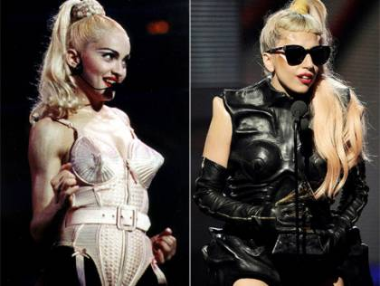
2. Nu cauta originalitate, ci autenticitate

Slide 6
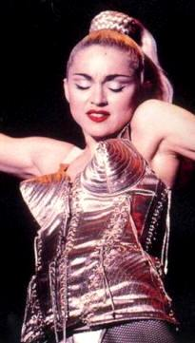
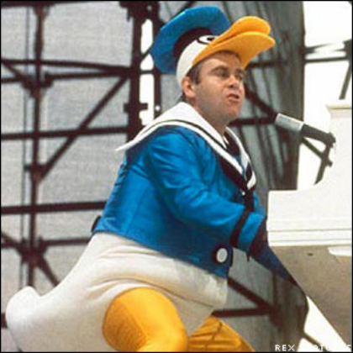
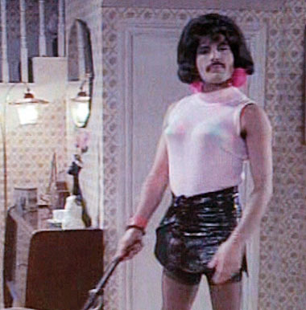
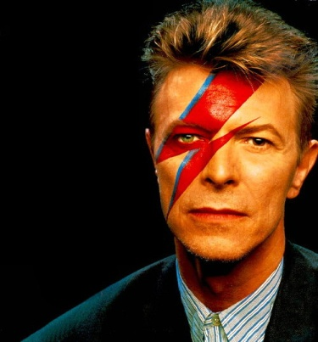
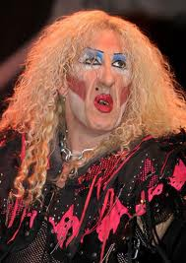
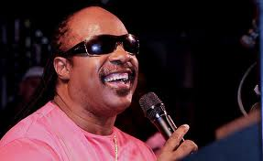
Adica?

Slide 7
Cum?
Invata de la competitori
Competitive research (Alexa, Compete, Quantcast, comScore, IAB Digital Directory, Trafic.ro, SATI, Google Trends, Google Ad Planner*)
“Fura” de la straini
Articole de tipul “top 10”
Premii pentru excelenta in online (Webby Awards, Web Marketing Association Awards, Forrester Public Websites Ranking, MyBankTracker, Smashing Magazine)
“Retailers treat customers as transient, banks treat customers like captives” (Gareth Jones, Finextra)

Slide 8
3. Cauta sa fii cel mai bun

Slide 9
Adica?
1 American Music Award
2 ARIA Music Awards
1 Big Women Of The Year Award
20 Billboard End-Of-Year Chart Awards
7 Billboard Music Awards
8 BMI Awards
3 Brit Awards
4 ECHO Awards
1 premiu Emmy
5 premii Grammy
13 MTV Video Music Awards
3 People’s Choice Awards
1 TRL Award
5 World Music Awards
=> 222 premii, 347 nominalizari in 4 ani de cariera

Slide 10
Cum?
Invata ca nu esti o masinarie
Construieste-ti o identitate (brand book)
Strategie de content
Timing
Abordeaza un tone of voice uman
Fii umil (multumeste clientilor, asculta-i, interactioneaza cu ei)
Nu te teme sa incerci ceva nou!
Intelege mediul inainte de a te avanta
Angajeaza oamenii potriviti
Creeaza infrastructura potrivita (chain of command / decision-making)
Creeaza un sistem multi-departament cat mai eficient (cu roluri bine definite)

Slide 11
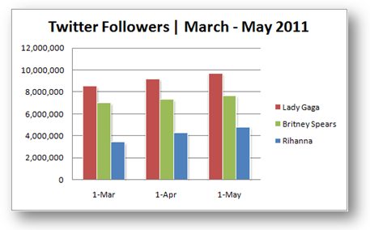
4. Inainte de a fi creativ, fii analitic

Slide 12
Cum?
Web analytics
Usability testing
Split testing, A/B testing
Eye tracking
Focus groups
Clickmaps
Social analytics
Cunoaste-ti CMS-ul
Afla ce vrei, de fapt (business objectives – goals – KPIs - metrics)
Construieste un plan coerent
Navigare si structura
Elemente tehnice
User-friendliness
Copy on-site
Calls to action (pornind de la obiective)

Slide 13
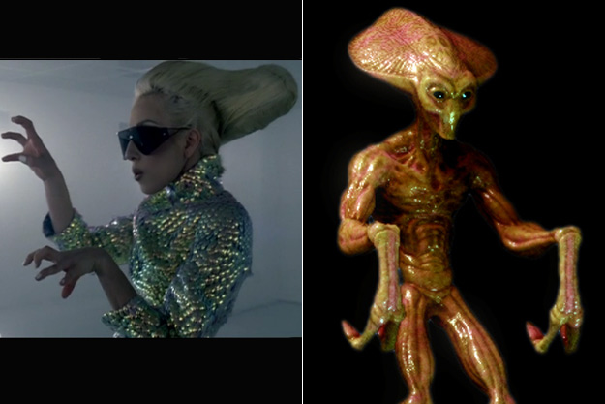
5. Fii inovator si priveste catre viitor

Slide 14
Cum?
Crowdsourcing
ABN Amro Blackboard (ABN Amro net banking review)
Citi Innovation Loop (product innovation cu client feedback)
Wells Fargo Labs
Idea Bounty (Capitec Bank, Africa de Sud)
Apps for Development (World Bank)
DBS Singapore – competitie pentru branch design concept
Web analytics – behavioural analysis – call center software integration
Online branch / branchless
Ally Bank
Bank Of Internet
iGo Banking
Convergenta online – mobile
Tabletizarea net banking
Personalizare

Slide 15
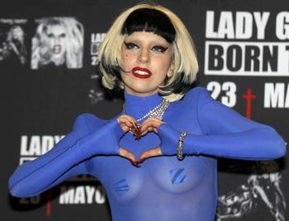
Thank you, my little marketing monsters!
http://twitter.com/seowolf
http://fb.me/neaguhoria

