Slide 1
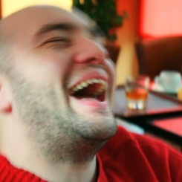
10 advice for link building
Tudor Totolici – http://tudortotolici.ro
Lumea SEO PPC – 24 iulie 2010

Slide 2
Plan, plan & plan again Organize & Prioratize And be really, really patient
Tudor Totolici – http://tudortotolici.ro
Lumea SEO PPC – 24 iulie 2010

Slide 3
Thank you! And have a nice weekend ☺
Tudor Totolici – http://tudortotolici.ro
Lumea SEO PPC – 24 iulie 2010

