Slide 1
10 despre Google Analytics
de Gabi Nistoran
web-analytics.ro

Slide 2
#1 Integrare cu Webmaster Tools

Slide 3
#2 Masurare timp de incarcare

Slide 4
#3 Rapoarte Social Media

Slide 5
#4 Segmentare Keywords

Slide 6
#5 Editare lista search engines
Google Yahoo MSN Lycos Ask Altavista Netscape CNN Looksmart About Mamma Alltheweb Gigablast Voila Virgilio Live Baidu Alice Yandex Najdi AOL Club-Internet Mama Seznam Search Wp Onet Netsprint Google.interia Szukacz Yam Pchome

Slide 7
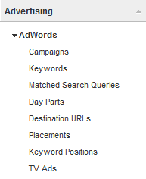
#6 Tracking campanii

Slide 8
#7 Multi-Channel Funnels

Slide 9
#8 In-Site Search

Slide 10
#9 Comportament, loialitate...

Slide 11
#10 Google Analytics...
IS JUST
A TOOL

Slide 12
Multumesc!
web-analytics.ro

