Slide 1
FERITI-VA DE
ULEIUL DE SARPE SEO!
#51
Horia Neagu
27.04.2012

Slide 2
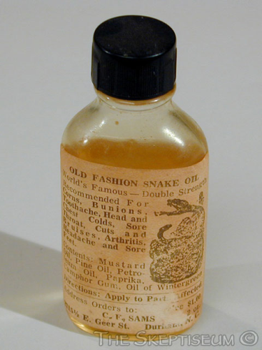
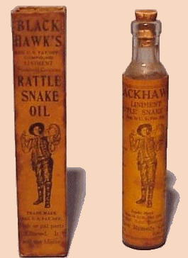
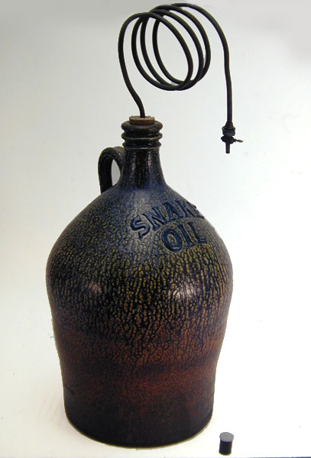
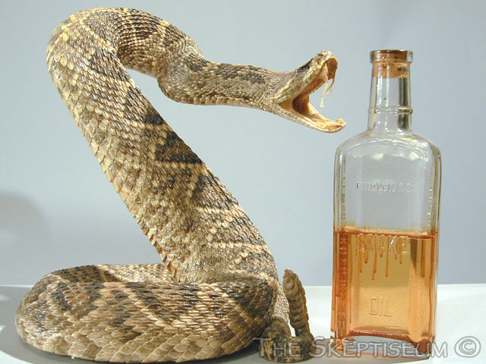
ULEI DE SARPE?

Slide 3
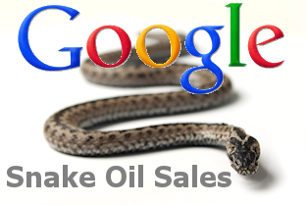
ULEI DE SARPE SEO
Popularizarea masiva a SEO
Constientizarea nevoii de SEO
Descoperirea potentialului financiar
Aparitia escrocilor
Disruptia pietei

Slide 4
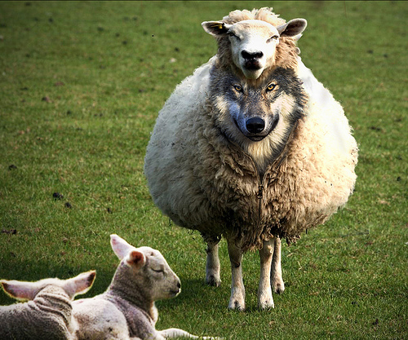
GARANTAM PRIMA POZITIE IN GOOGLE
Va garantez ca nu va voi manca.

Slide 5
GARANTAM PRIMA POZITIE IN GOOGLE

Slide 6
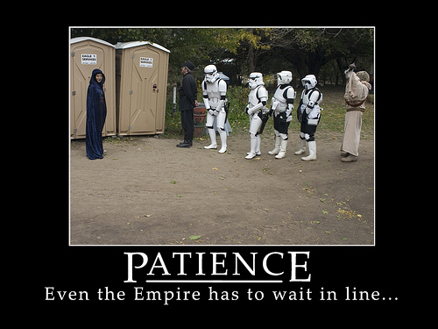
RANKING TOP 10 IN MAI PUTIN DE 30 DE ZILE

Slide 7
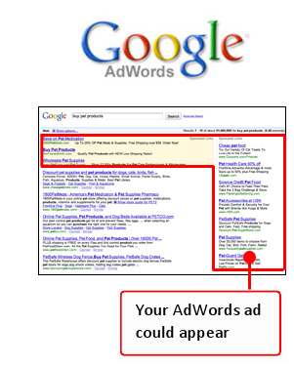
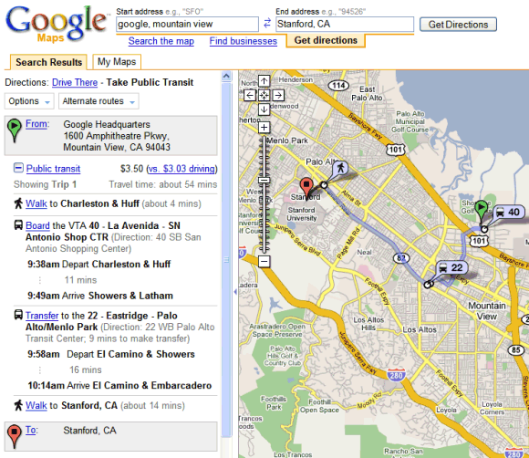
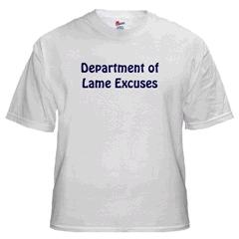
RANKING TOP 10 IN MAI PUTIN DE 30 DE ZILE
Nu se poate, la mine in Google apare pe prima pozitie, uitati…
Google Maps
Editare de screenshots
AdWords = SEO
SAU
AdWords ajuta la SEO
Minciuni

Slide 8
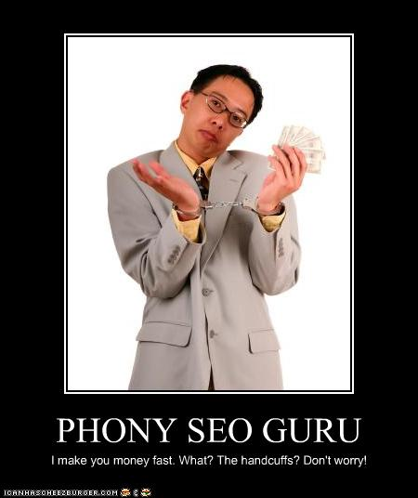
VA VOM INSCRIE SITE-UL IN 10.000 DE DIRECTOARE SI MOTOARE DE CAUTARE

Slide 9
VA VOM INSCRIE SITE-UL IN 10.000 DE DIRECTOARE SI MOTOARE DE CAUTARE
99,99%
10.000 de motoare de cautare
10.000 de directoare

Slide 10
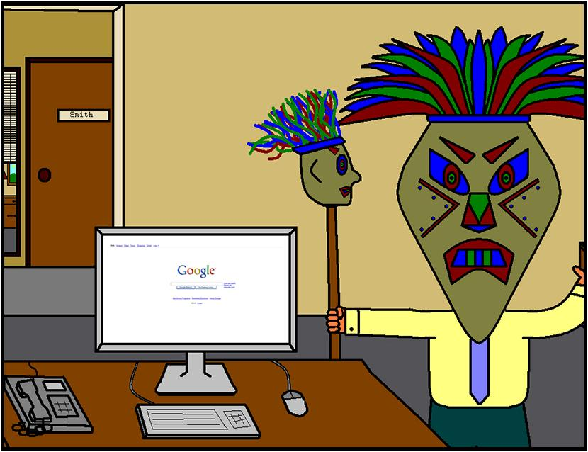
METODELE NOASTRE SUNT SECRETE, NU LE PUTEM DIVULGA

Slide 11
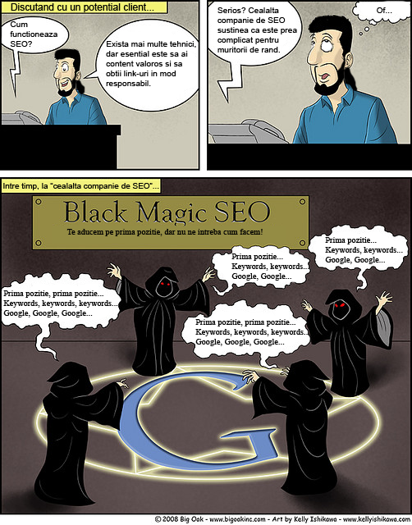

Slide 12
Cum functioneaza SEO?
Serios? Cealalta companie SEO sustinea ca este prea complicat pentru muritorii de rand.
Esential este sa ai content valoros si sa obtii link-uri in mod responsabil.
Of…
Black Magic SEO
Te aducem pe prima pozitie, dar nu ne intreba cum facem!
Prima pozitie, prima pozitie…
Keywords, keywords…
Google, Google…

Slide 13
METODELE NOASTRE SUNT SECRETE, NU LE PUTEM DIVULGA

Slide 14
STIM PE CINEVA DE LA GOOGLE / SUNTM PARTENERI GOOGLE / CUNOASTEM ALGORITMUL

Slide 15
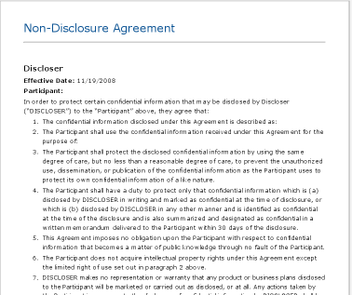
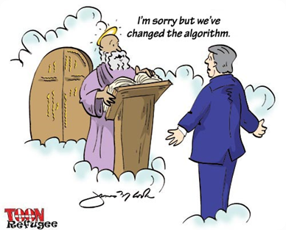
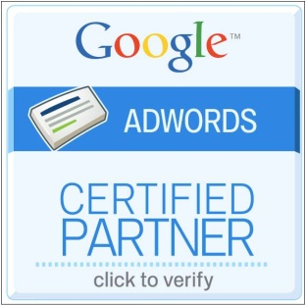
STIM PE CINEVA DE LA GOOGLE / SUNTM PARTENERI GOOGLE / CUNOASTEM ALGORITMUL

Slide 16
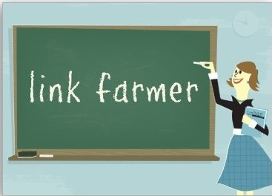
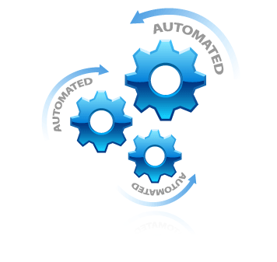
VOM GENERA MII DE LINK-URI CATRE SITE-UL DUMNEAVOASTRA

Slide 17
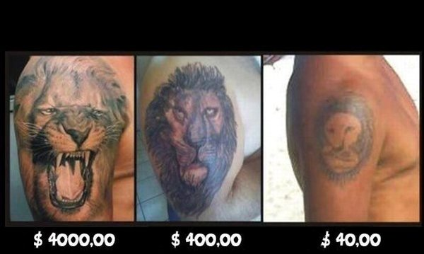
CELE MAI IEFTINE SERVICII SEO / CHILIPIR / FLAT RATE LUNAR
You get what you pay for…

Slide 18
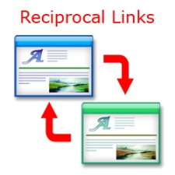
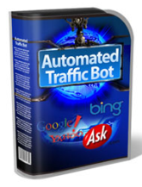
ALTE INSELATORII
Va facem un site full flash si includem si SEO in pachet.
Alexa Rank va fi unul din KPI in campania SEO.
Vom genera mii de link-uri reciproce pentru site-ul Dvs.
Vom genera zeci de mii de vizite catre site-ul Dvs.
Revendicam ownership pe copy si meta.

Slide 19
CUM STABILIM OBIECTIVELE
Corporate Priorities | Business Objectives | Goals | KPIs | KPI Target
Reach out to more customers | Grow active customer base | Increase interest in contacting customer service | Traffic to "Contact Us" page | X
 |  | Turn the website into a one-stop source of information | Traffic to "Useful Info" page | X
 |  |  | Access of product info form
 |  |  | Brochure downloads
 |  | Increase lead profitability | Average value per lead | X
 |  | Increase conversion profitability | Average order value | X
Focus on business growth | Strengthen market position | Enhance Search Engine rankings | Google ranking for <keyword> | X
 |  |  | Google ranking for <keyword> | X
 |  |  | Google ranking for <keyword> | X
 |  |  | Google ranking for <keyword> | X
 |  |  | Google ranking for <keyword> | X
 |  | Attract more visitors via Search Engines | Organic traffic | X
 |  |  | Non-branded vs branded keywords | X
 |  | Generate more Search Engine results vs competitors | Share of search | X
Simplify our services | Delivering value to customers | Increase customer interaction | Newsletter sign-ups | X
 |  | Enhance visitor retention rates | Visitor loyalty | X
 |  |  | Visitor recency | X
 |  | Make sure visitors find what they're looking for | Task completion rate - Task 1 | X
 |  |  | Task completion rate - Task 2 | X
 |  |  | Task completion rate - Task 3 | X
 |  | Stimulating customer interest in the website | Length of visit | X
 |  |  | Depth of visit | X

Slide 20
VA MULTUMESC!
@seowolf
gplus.to/seowolf
fb.me/neaguhoria
seo-wolf.com
linkd.in/neaguhoria
neaguhoria@gmail.com

