Slide 1
When
September
came

Slide 2
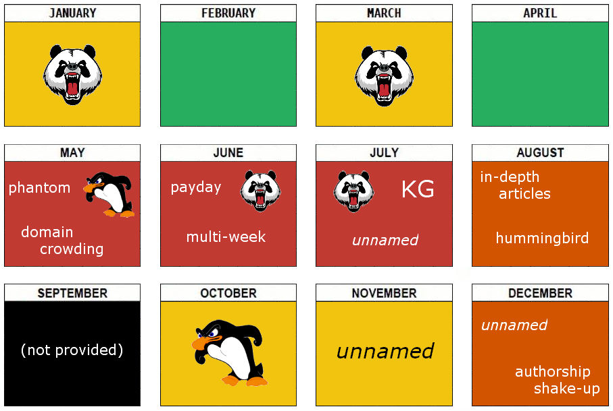
2013 in review

Slide 4
Duplication

Slide 5
Thin
Content

Slide 6
Internal
Search

Slide 7
Ads

Slide 8
Fingerprinting

Slide 9
Auditing

Slide 11
Backlinks

Slide 12
Analysis

Slide 13
Disavow

Slide 15
?!

Slide 16
GWT + GAT

Slide 17
Microniches

Slide 18
Now what?

Slide 19
Use
protection!

Slide 20
Continuous
auditing

Slide 21
Backlinks
monitoring

Slide 22
MozCast

Slide 23
SERPmetrics

Slide 25
Thanks!
George Maicovschi
System Architect @ OpenS (http://opens.org)
@encu

